Slide 1
Niner Transit Data
Autumn Horrell, Felipe Orrego, Django Yepidan, Thien Nguyen, Jaren Robbins

Slide 2
Overview
The Niner Transit system is a widely used transportation service provided by UNCC for students and faculty to use. However, with the exponential growth of riders, the system needs to adapt to the increasing efficiency standards.
Through analyzing the data given to us, we visualized the information to make conclusions regarding the optimization of the transit system.

Slide 3
Sprints Summary
Sprint 1
Created user stories to outline project purposes
Constructed a low level prototype
Sprint 2
Updated user stories
Visualized the data by using maps and graphs
Sprint 3
Updated user stories
Answered our project focused questions

Slide 4
User Stories / Questions
User Story 1
User Story 2
Questions
As a UNCC student, I would like to find optimal bus routes to my destination
Using R and a shiny app will give us visuals that could lead us to optimal bus routes
As a UNCC student, I would like to see more interactive visualizations regarding the Niner Transit system
Steamlit is a great tool that provides interactive and customizable graphs and other visuals based on our data
What are some interactive ways to visual the data?
What are the busiest times for the transit system?
What are the optimal bus routes?

Slide 5
Streamlit Visualization Demo

Slide 6
Optimal Routes
We came up with building a clustering model, which is an unsupervised machine learning model, to help us find an answer for the question “How to optimize the bus routes to make our Transit Niner System more efficient and convenient for our UNCC community?”
Our clustering model helps us define which bus stops we should remove and which stops we need to keep to make our routes optimal based on the average number of passengers getting on and off at each bus stop.
Before building the clustering model, we need to first define the optimal cluster number that is suitable for our Transit dataset.
We used Silhouette Method, which is one of the most accurate method to find the optimal number of clusters.
The silhouette method computes silhouette coefficients of each object that measure how much an object is similar to its own cluster compared to other clusters

Slide 7
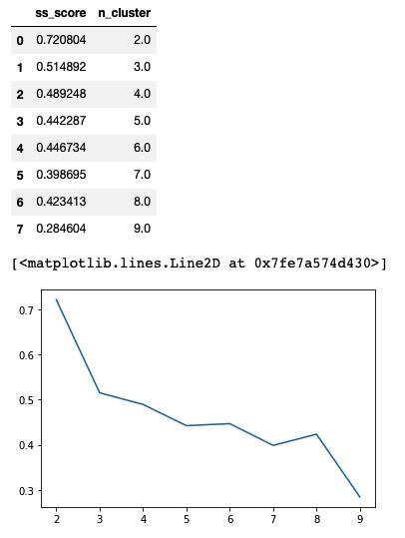
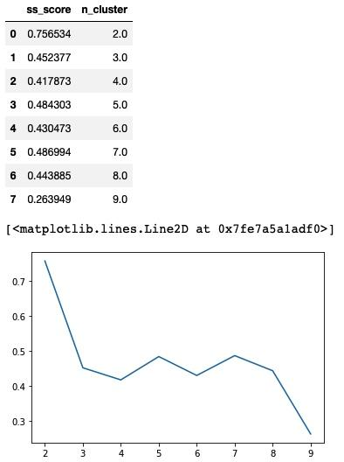
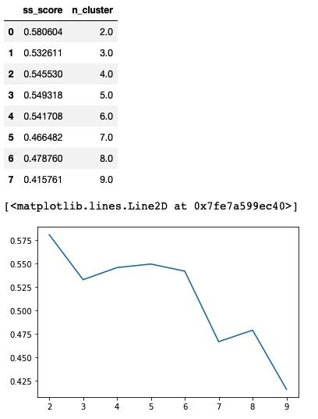
Silhouette Method
Gold Line Clusters
Green Line Clusters
Silver Line Clusters

Slide 8
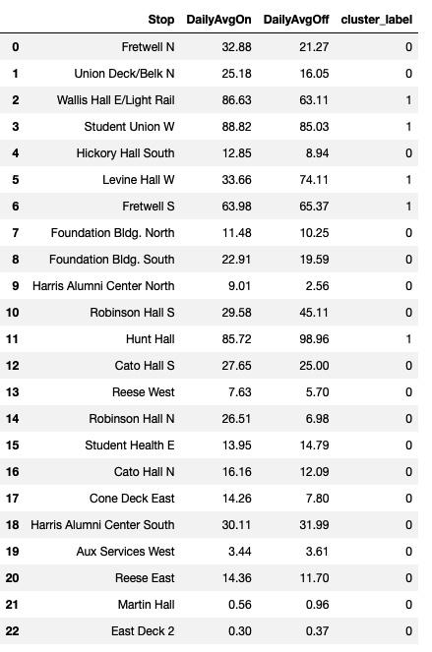
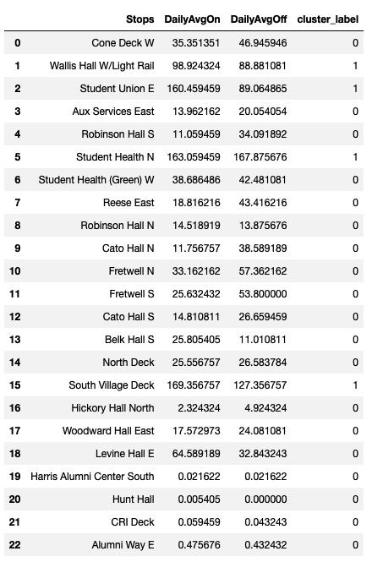
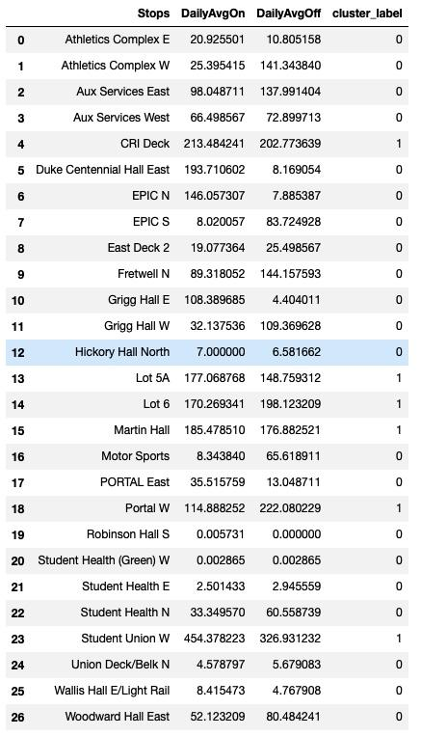
Clustering Model
Gold Line
Green Line
Silver Line

Slide 9
Conclusion
Initial Questions:
What are some interactive ways to visual the data?
What are the busiest times for the transit system?
What are the optimal bus routes?
We were able to successfully create interactive ways to visualize our data
We found the busiest times for the transit system, but inconclusive as to whether or not adding more buses would make the line more efficient - need real-world testing
We used machine learning and clustering to find which stops would make the line more efficient, but the amount of time the a line would take to make a round is inconclusive as there are other variables to take into account.
Overall, we learned a lot about using data to solve a real world problem, and although we weren’t able to get a definitive answer, we feel like we have gathered adequate data to get started on making the niner transit more efficient.

